Slide 1
RRAM Array Bring-Up: TSMC 64K Cell (256x256)
Akash Levy
Stanford University
2/19/21
Notes:
This presentation will attempt to kill two birds with one stone
It will be structured as a 15 min crash course on how to test an RRAM array, with the TSMC RRAM array as a case study
Assumptions: direct access to the memory array (with address decoders)

Slide 2
READ
Step One

Slide 3
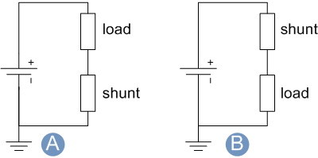
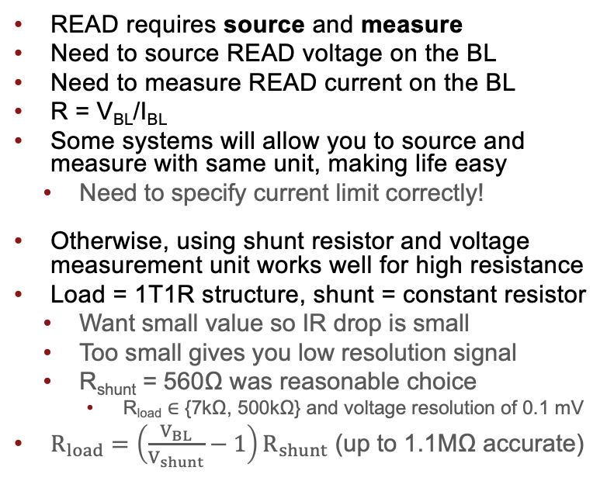
READ Operation
READ requires source and measure
Need to source READ voltage on the BL
Need to measure READ current on the BL
R = V_{BL}/I_{BL}
Some systems will allow you to source and measure with same unit, making life easy
Need to specify current limit correctly!
Otherwise, using shunt resistor and voltage measurement unit works well for high resistance
Load = 1T1R structure, shunt = constant resistor
Want small value so IR drop is small
Too small gives you low resolution signal
R_{shunt} = 560Ω was reasonable choice
R_{load} ∈ {7kΩ, 500kΩ} and voltage resolution of 0.1 mV
$R_{load}=\left(\frac{V_{BL}}{V_{shunt}}−1\right)R_{shunt}$ (up to 1.1MΩ accurate)
Shunt resistor setup
Measure voltage here
VBL
V_{shunt}
First test with constant resistor as load!

Slide 4
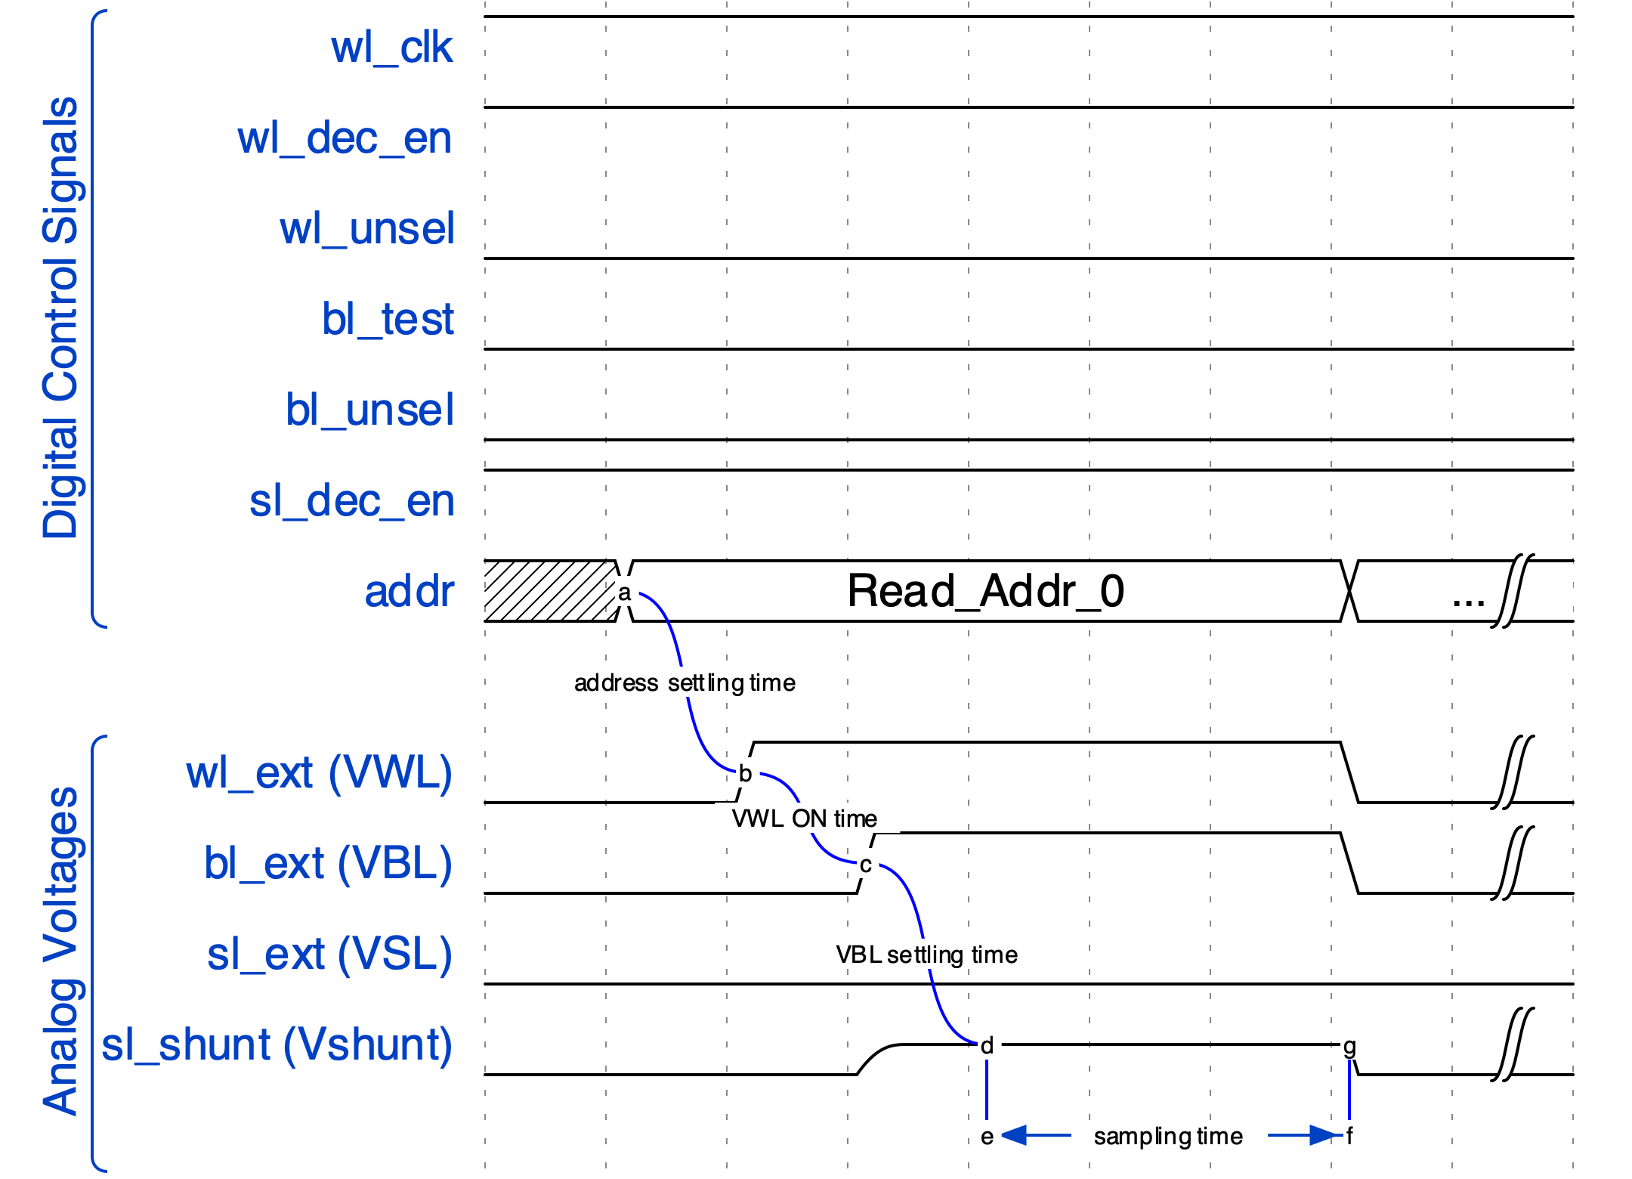
READ Waveform: Always Verify with Scope
Set VSL=0V
Set VWL=2.5V
Higher VWL means less transistor resistance included in measurement
Set VBL=200mV
Yields good signal with low read disturb
Find conservative settling times
Address settling time (500us)
VWL ON time (SW timed)
VBL settling time (2ms)
Sampling (100Sa @ 1 MSa/s)
NOTE: there are other valid waveforms that work
https://tinyurl.com/rram-read-waveform

Slide 5
Single-Bit Operation Conditions
Operation | READ | FORM | SET | RESET
BL/SL Start (V) | 0.2 (BL)
BL/SL Stop (V) | N/A
BL/SL Step (V) | N/A
WL Start (V) | 2.5
WL Stop (V) | N/A
WL Step (V) | N/A
WL Pulse Width (us) | 2000
Stop Condition | N/A
Loop Order | N/A

Slide 6
FORM
Step Two

Slide 7
FORM Waveform: Always Verify with Scope
Before FORMing, it is not possible to test your READ waveform
The first step is to just apply a long SET pulse (will show in a few slides)
Example: VBL=3V, VWL=4V, VSL=0V
Then READ, and check that resistance dropped significantly
If it does, this is the first sign that your device is alive! ☺
Now try to do “dynamic FORM”:
FORM_THRESH, FORM_PW = 50E3, 1000 # 50kOhm FORMing threshold, 1ms
for VWL in range(0, 2, step=0.05): # VWL outer loop
for VBL in range(2, 4, step=1): # VBL inner loop, optional (can fix VBL val)
PULSE(VBL, VWL, VSL=0, FORM_PW) # FORMing pulse
if READ() <= FORM_THRESH:
print(‘FORM succeeded’)
break
else: # if loop completes without break
print(‘FORM failed’)

Slide 8
Full-Array FORMing Yield
Small number of FORM failures due to 1.5V VWL limit & 200us PW
Failures happen further down the BL/WL, probably due to IR drop
Important not to over-SET
Do not increase VWL limit!
Instead: increase PW or do rerun
Rerunning FORM for failed cells successfully FORMed 38/39
Rerunning a second time on the final failed cell FORMed it
Result: 100% FORM yield!
Afterwards: perhaps adjust PW
Initial:
39 Failures…

Slide 9
Full-Array FORMing Statistics
Certain BLs seem to have higher VWL (every 8 or so) and hence lower resistance
Not sure why this might be the case… any ideas?

Slide 10
Full-Array FORMing Statistics

Slide 11
Single-Bit Operation Conditions
Operation | READ | FORM | SET | RESET
BL/SL Start (V) | 0.2 (BL) | 2
BL/SL Stop (V) | N/A | 4
BL/SL Step (V) | N/A | 0.5
WL Start (V) | 2.5 | 0.9
WL Stop (V) | N/A | 1.5
WL Step (V) | N/A | 0.05
WL Pulse Width (us) | 2000 | 1000
Stop Condition | N/A | < 50kΩ
Loop Order | N/A | WL outer/ BL inner

Slide 12
Single-Bit Program: SET/RESET
Step Three

Slide 13
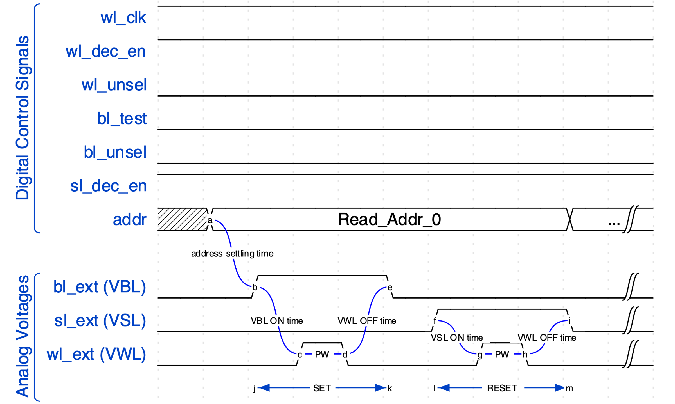
SET/RESET Waveform: Always Verify with Scope
Reuse dynamic FORM template
Pulse VWL
Find good timing
Address settling time (500us)
VBL/VSL ON time (SW timed)
PW (10us)
VWL OFF time (SW timed)
NOTE: there are other valid waveforms that work
https://tinyurl.com/rram-set-reset-waveform

Slide 14
Dynamic SET/RESET & TARGET (Write-Verify)
def dynamic_set(SET_THRESH=11E3, SET_PW=10):
for VWL in range(0, 2, step=0.05):
for VBL in range(2, 4, step=1):
PULSE(VBL, VWL, VSL=0, SET_PW)
R = READ()
if R <= SET_THRESH:
print(‘SET succeeded’)
break
else: print(‘SET failed’)
return R
def dynamic_reset(RST_THRESH=100E3, RST_PW=10):
for VWL in range(0, 2, step=0.05):
for VSL in range(2, 4, step=1):
PULSE(VWL, VSL, VBL=0, RST_PW)
R = READ()
if R >= RST_THRESH:
print(‘RESET succeeded’)
break
else: print(‘RESET failed’)
return R
def target(Rmin, Rmax, MAXI=5):
for i in range(MAXI):
R = READ()
if R > Rmax:
R = dynamic_set(Rmax)
if R < Rmin:
R = dynamic_reset(Rmin)
if Rmin < R < Rmax:
print(‘TARGET succeeded’)
break
else:
print(‘TARGET failed’)
return R

Slide 15
Checkerboard: Random Access Pattern Check
Error with single cell FORMed at VWL=1.7V
Cell cannot be fully RESET, only up to 20kOhm

Slide 16
“Anti-Checkerboard”: Random Access Pattern Check
3 errors when trying to flip
Cells cannot be fully RESET on first pulse, only up to 20-40 kOhm
Happens if cells are over-FORMed: shows importance of proper FORMing

Slide 17
Operation conditions
Operation | READ | FORM | SET | RESET
BL/SL Start (V) | 0.2 (BL) | 2 | 2 | 3
BL/SL Stop (V) | N/A | 4 | 2 | 3
BL/SL Step (V) | N/A | 0.5 | N/A | N/A
WL Start (V) | 2.5 | 0.9 | 0.9 | 0.9
WL Stop (V) | N/A | 1.5 | 1.5 | 1.5
WL Step (V) | N/A | 0.05 | 0.1 | 0.1
WL Pulse Width (us) | 2000 | 2000 | 10 | 10
Stop Condition | N/A | < 50kΩ | Below target (11kΩ) | Above target (100kΩ)
Loop Order | N/A | WL outer/ BL inner | WL only | WL only
Total FORM Time:
~3 cells/s
=
7 hrs/array
Total Prog Time:
~4 cells/s
=
6 hrs/array

Slide 18
Full-Array Programming (Iteration 1)

Slide 19
Full-Array Programming (Iteration 2)

Slide 20
Full-Array Programming (Iteration 3)

Slide 21
Multi-Bit Programming
Step Four

Slide 22
Find the SET/RESET “Limits”
For multi-bit programming, you care a lot about the dynamic range
Indicates multi-bit tunability
Over-SET: if resistance goes too low, transistor will not be able to pass enough current to RESET
Device Shorting: happens if current is too high through the device
Caused by VWL being too high
Find the minimum resistance and maximum VWL
Note that all these values may vary significantly die-to-die!

Slide 23
Characterization Sweeps
ISPP Characterization
Ramp VWL with fixed VBL/VSL starting from “fully SET/RESET state” and observe the trajectory
Other ramping sweeps
VBL/VSL ramping with fixed VWL
Fixed-Pulse SET Characterization
Try fixed voltage pulses instead of ramping
This is useful for determining a good “starting point” for ISPP

Slide 24
VWL SET Sweeps
Same as standard ISPP Algorithm

Slide 25
ISPP: VWL SET Sweeps (Resistance, Large PW)

Slide 26
ISPP: VWL SET Sweeps (Resistance, Small PW)

Slide 27
ISPP: VWL SET Sweeps (Conductance, Large PW)
No READ disturb below 0.4V
Dynamic range seems to be ~0-120uS

Slide 28
ISPP: VWL SET Sweeps (Conductance, Small PW)
Smaller PW gives more linear behavior
But more variability(?)

Slide 29
VBL SET Sweeps

Slide 30
VBL SET Sweeps (Resistance, Large PW)
SET around 1V
Fine Tuning

Slide 31
VBL SET Sweeps (Resistance, Small PW)

Slide 32
VBL SET Sweeps (Conductance, Large PW)

Slide 33
VBL SET Sweeps (Conductance, Small PW)

Slide 34
VWL RESET Sweeps

Slide 35
VWL RESET Sweeps (Resistance, Large PW)
Highly abrupt and stochastic behavior
SHORT!

Slide 36
VWL RESET Sweeps (Resistance, Small PW)
Highly abrupt and stochastic behavior
SHORT!
No response
Do not push past VWL=3.5V, VSL=4V!

Slide 37
VWL RESET Sweeps (Conductance, Large PW)
150 uS is too high, can’t be RESET
120 uS seems to be okay
SHORT!
Highly abrupt and stochastic behavior
“Safe” tuning window
No response

Slide 38
VWL RESET Sweeps (Conductance, Small PW)
No response

Slide 39
VSL RESET Sweeps

Slide 40
VSL RESET Sweeps (Resistance, Large PW)
Best Gradual RESET

Slide 41
VSL RESET Sweeps (Resistance, Small PW)
Abrupt RESET
No response

Slide 42
VSL RESET Sweeps (Conductance, Large PW)
Abrupt RESET
Best Gradual RESET

Slide 43
VSL RESET Sweeps (Conductance, Small PW)

Slide 44
Conductance Tuning Curves

Slide 45
Conductance Tuning Curve (using TARGET)
Now we know the dynamic range of the RRAM
We also know good SET/RESET voltages to use
Using TARGET, we can now tune within our conductance window
Choose 0-128 uS and have 16 evenly spaced target ranges
Programming once will give bad relaxation
Do tail distribution reprogramming (TDR) to fix cells that quickly relax out of target range

Slide 46
Conductance Tuning Curve (after relaxation)
Now we know the dynamic range of the RRAM
We also know good SET/RESET voltages to use
Using TARGET, we can now tune within our conductance window
Choose 0-128 uS and have 16 evenly spaced target ranges
Programming once will give bad relaxation
Do tail distribution reprogramming (TDR) to fix cells that quickly relax out of target range

Slide 47
Conductance Tuning Curve (5 iters of TDR w/relaxation)
Now we know the dynamic range of the RRAM
We also know good SET/RESET voltages to use
Using TARGET, we can now tune within our conductance window
Choose 0-128 uS and have 16 evenly spaced target ranges
Programming once will give bad relaxation
Do tail distribution reprogramming (TDR) to fix cells that quickly relax out of target range
Even spacing of the ranges is probably the wrong thing to do
Need something like sigma-based allocation
Also better pulsing/pre-cycling…

Slide 48
Conductance Tuning Curve: Confusion Matrix

Slide 49
Short-Term Retention Behavior
Do many READs after programming and observe statistical behavior

Slide 50
Retention using ISPP SET

Slide 51
Retention using ISPP RESET

Slide 52
Retention using TARGET

Slide 53
Endurance Measurement (Preliminary)
No write-verify needed
Degradation of window & high variab.
Shorted
SET: VBL=3V, VWL=2V, PW=50us, RESET: VSL=3V, VWL=3V, PW=20us

Slide 54
TODO
There’s always more…

Slide 55
More Measurements/Experiments
Sigma-Based Allocation for better multi-bit programming
More detailed retention study…
Goldilocks FORMing
Endurance: what are the variables that affect it
Charge-based Write
Smarter Programming (RADAR)
Variability
Cycle-to-cycle variations
Cycle the same cell and view distribution
Array location variations
We have already investigated this for FORMing but not for other ops
One challenge with the TCAM chip is that there are 4 different drivers for WLs and 2 different drivers for BLs which introduce further variation in the behavior
Die-to-die variations
Non-linear Behavior
Use different READ voltages and observe current
High-Temperature Retention and Long-Term Retention
Bake chip and observe changes in resistance
Can extract activation energies and estimate device lifetime via extrapolation
MORE IDEAS?

Slide 56
Thank you!
(If you are interested in the RRAM data or using the LabVIEW program, contact Akash at akashl@Stanford.edu)

Slide 57
Me: Mom, can I have multi-bit RRAM? Mom: No, we have multi-bit RRAM at home Multi-Bit RRAM at Home:

